Slide 1




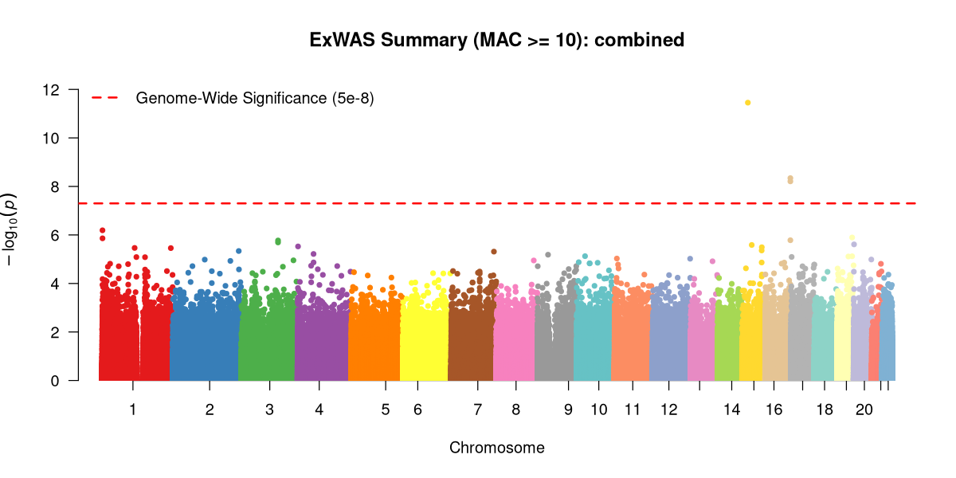
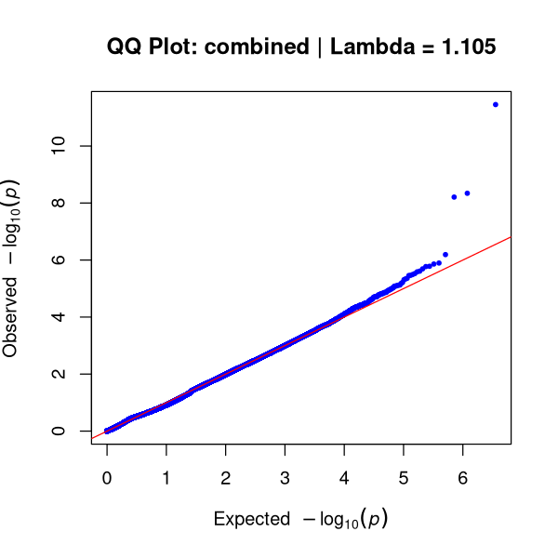
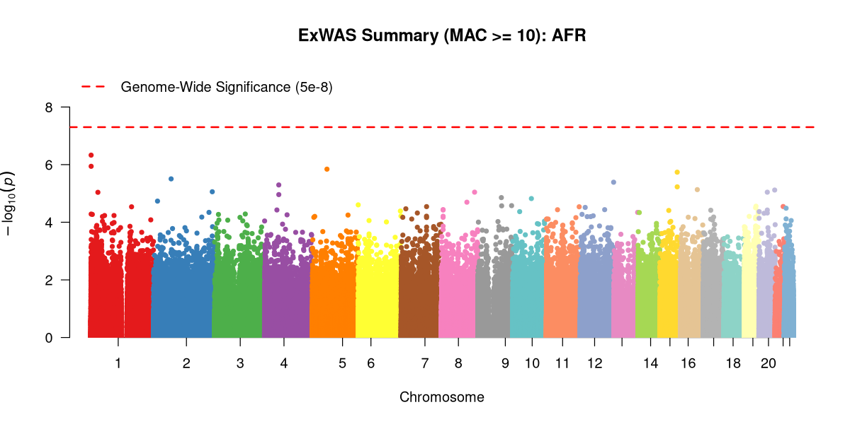
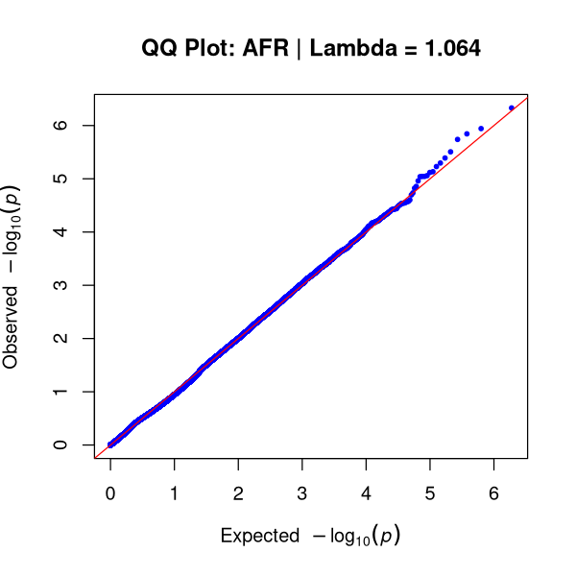

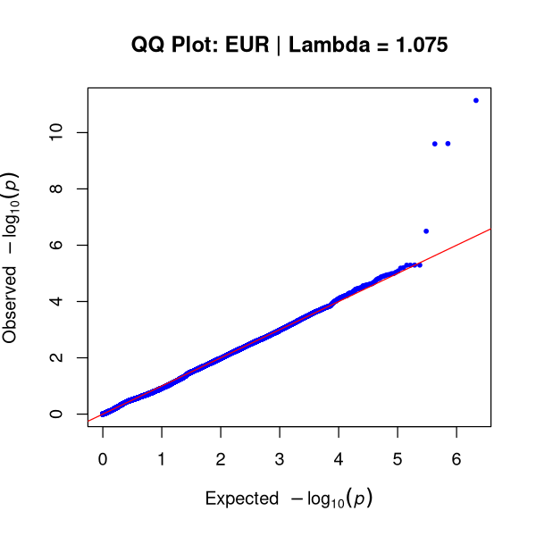
1
Exome-wide Association Study (ExWAS) of Hearing Loss
in the Penn Medicine BioBank (PMBB)
Elena Sretenović¹, Nicole Palmiero¹, Andre Rico¹, Molly A Hall¹, Doug Epstein¹
Department of Genetics, Perelman School of Medicine, University of Pennsylvania
Introduction
Combined
Age-related hearing loss is one of the most common sensory disorders worldwide and can arise from genetic factors
While many congenital hearing loss genes have been identified, the genetic contributors to adult-onset hearing loss remain incompletely understood.
Large biobank datasets containing exome sequencing and electronic health record (EHR) information provide opportunities to discover genes associated with complex hearing phenotypes.
Exome-Wide Association Studies (ExWAS) evaluate protein coding variants across the allele-frequency spectrum for association with disease phenotypes.
Previous analyses with earlier releases of the Penn Medicine BioBank (PMBB) identified ZNF175 as a candidate hearing loss gene due to its strong association with tinnitus and suggestive association with hearing loss.
Functional studies in mice further support ZNF175’s role as a hearing loss gene, as disruption of the mouse ortholog, Zfp719, results in hearing loss in mice.
Genome Wide Significant Results Total: 6
Gene | Variant | Cohort | P-Value
KNL1 | chr15:40611486:A:G | Combined | 3.51e-12
KNL1 | chr15:40611486:A:G | EUR | 7.21e-12
ZFPM1 | chr16:88533289:A:C | EUR | 2.46e-10
ZFPM1 | chr16:88533290:G:C | EUR | 2.52e-10
ZFPM1 | chr16:88533290:G:C | Combined | 4.54e-9
ZFPM1 | chr16:88533289:A:C | Combined | 6.18e-9
AFR
Here, I aim to evaluate the association between ZNF175 and hearing loss and search for novel hearing loss genes through a ExWAS in PMBB v4
Unique Significant Variants Total: 3
Gene | Variant | Function
KNL1 | chr15:40611486:A:G | Important in chromosome segregation and cell division
ZFPM1 | chr16:88533289:A:C | Encodes a zinc finger protein that functions as a transcriptional cofactor
ZFPM1 | chr16:88533290:G:C
Methods & Statistical Analysis
EUR
Phenotype definition: Cases and controls were defined using ICD-10 codes H90, H91, and H93 to identify hearing loss and tinnitus phenotypes.
Quality Control and Minor Allele Filtering: To minimize statistical noise and control genomic inflation, variants with a genotype call rate < 0.99 and a Minor Allele Frequency (MAF) < 0.01 were removed.
Single-Variant Association Testing (ExWAS): Single-variant association analyses were performed across individuals of African (AFR) and European (EUR) genetic inferred ancestry and a combined ancestry cohort using SAIGE. Covariates age, age², sex, and principal components (PCs) were included for adjustment
Fig 2. Manhattan plots of all (combined), African (AFR), and European (EUR) ancestry datasets. Genomic coordinates are plotted on the x-axis, with chromosomes alternating in color. The y-axis displays the negative base-10 logarithm of the association p-value. The dashed horizontal line denotes the genome wide statistical significance threshold (5e-8).
Fig 3. Quantile-Quantile (Q-Q) plots of observed versus expected -log10(p-values). The solid red diagonal line represents the expected distribution under the null hypothesis of no genetic association. The genomic inflation factor (lambda) evaluates population stratification and systemic bias.
Table 1. Genetic variants showing genome-wide significance across analysis cohorts. The top panel outlines all variants across all three cohorts meeting the significance threshold, while the bottom panel displays unique variants meeting the significance threshold and the function of the genes that the variants are found in.
Penn Medicine BioBank v4
Genotype Call Rate
> 0.99
SAIGE
Variants
MAF > 0.01
Results
Future Directions
Data Visualization
ZNF175 did NOT meet genome-wide single-variant threshold (5e-8) in this ExWAS for hearing loss.
  However, the top hits were heavily concentrated in zinc-finger protein genes and transcriptional regulators (ZFPM1)
  These findings suggest that zinc-finger proteins and transcriptional regulation may warrant further investigation in adult-onset hearing loss.
The majority of significant variants mapped to intronic regions or were computationally classified as benign by Ensembl VEP.
Genomic inflation factors indicated adequate statistical calibration and minimal evidence of systematic inflation.
Gene Burden Analyses: Aggregate rare coding variants within genes to identify cumulative rare variant associations that may not be detected through single-variant testing of common variants.
ZNF175 Investigation: Although ZNF175 was not associated with hearing loss in this study, it was associated with tinnitus in previous PMBB versions; evaluate the association with only tinnitus in a future ExWAS
External Replication: Validate the prioritized candidate variants and top genes in independent biobank cohorts like the UK Biobank or the All of Us Research Program.
Functional Validation: Eventually, investigate some of the top genes revealed by this ExWAS in mice (just as the ZNF175 gene was investigated and supported as a candidate hearing loss gene)
All Ancestry
Cases
Controls
Participants
African Ancestry
Cases
European Ancestry
Controls
Cases
Controls
Fig 1. ExWAS pipeline applied to PMBB v4 data
Acknowledgements
This work is supported by the following: Penn Genetics Summer Internship Program (PGSIP), University of Pennsylvania Research Trainee Affairs

